Slide 1
Risk Management using Dependency Structure Matrix
Ivan Petković
ivan.petkovic@elfak.ni.ac.rs
Faculty of Electronic EngiNeering
University of Niš

Slide 2
Overview
Risk assessment & management
What is Design Structure Matrix?
An efficient method based on DSM analysis for ranking component technology risk factors in a complex systems and processes
Example: risk problem of NASA’s robotic spacecraft
Implications on software development process

Slide 3
Risk management
Universal applicability, not only for IT projects
Risk assessment (identify risks and their impact)
Risk mitigation (prioritize, implement & maintain risk reducing measures)
Evaluation and assessment (continual process)
Risk factor should be higher for entities upon other entities rely
In large systems, interdependencies are common
Display those dependencies using matrix

Slide 4
What is DSM?
Use matrix consisted of individual tasks/entities within the process/system,
Analyze relationship between these entities with the aim to identify the key structure of the system/process
Entities are arranged into a square matrix A where each row and the corresponding column are associated to one of the tasks. This matrix is called the dependency structure matrix, or shorter DSM.

Slide 5
DSM example

Slide 6
What is DSM?
Values in each row indicate dependency on other entites
Higher the value, higher is their dependence.
Values in column j indicate which other entities depend from the entity j.
Diagonal entries of DSM are certainly equal to 0, since a component of a considered engineering system cannot influence itself.

Slide 7
DSM Strategy
Divide process or system into individual entities (tasks / sub processes)
Partition into Design modes
Analyze interdependencies between entities

Slide 8
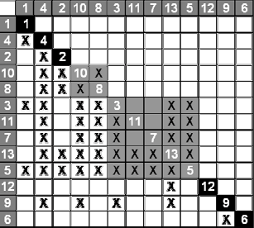
DSM partitioning
Entity partitioning leads to creating an optimal “Design mode” (small sub matrix). Done by switching columns and/or rows

Slide 9
Where is DSM used?
Large systems and complex processes – dependency between smaller parts
Software – complex relationship between assemblies or classes
Process (e.g. Software development) – many smaller interdependent tasks
Design iteration – interaction among design activities

Slide 10
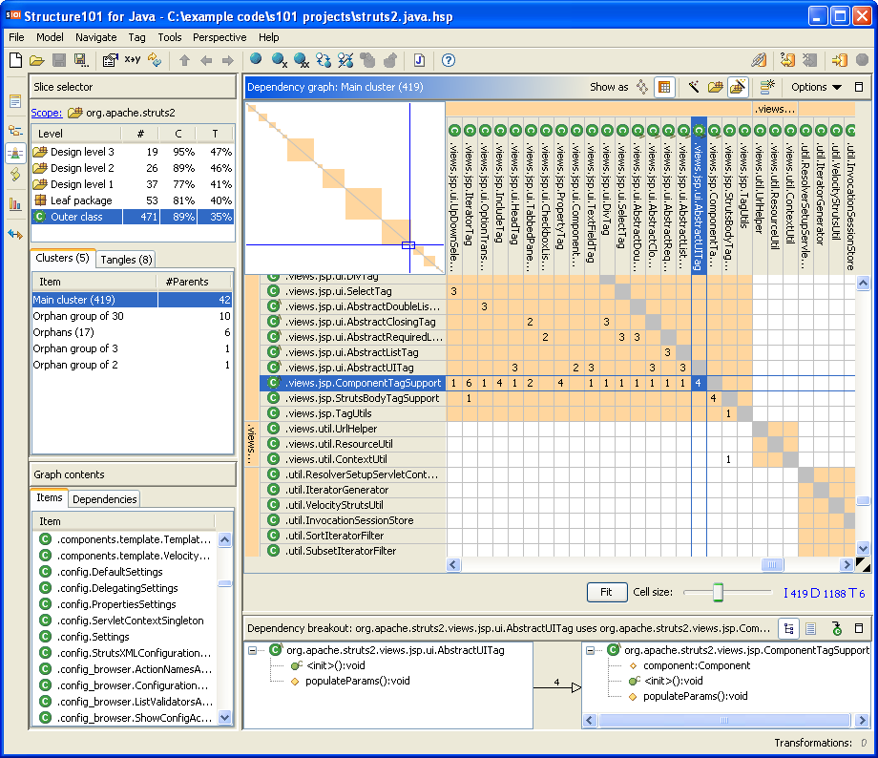
Structure101 (Java)

Slide 11
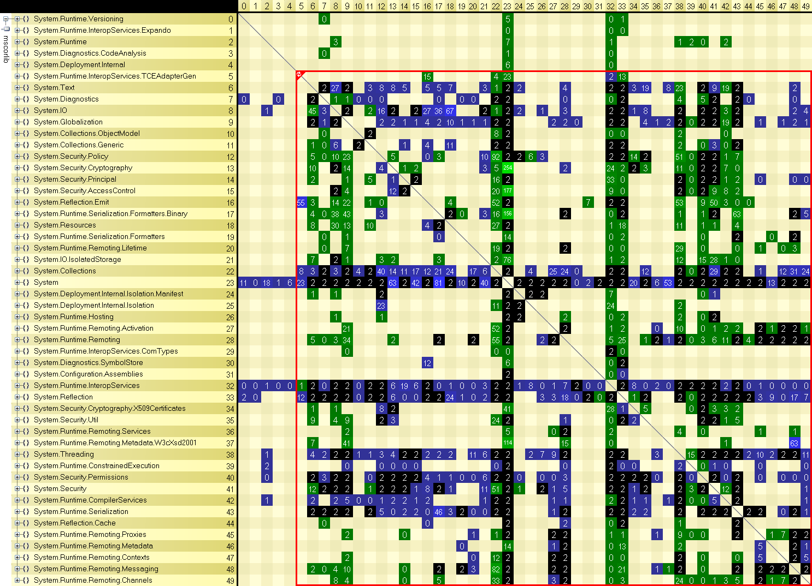
NDepend (Visual Studio 2010 plugin)

Slide 12
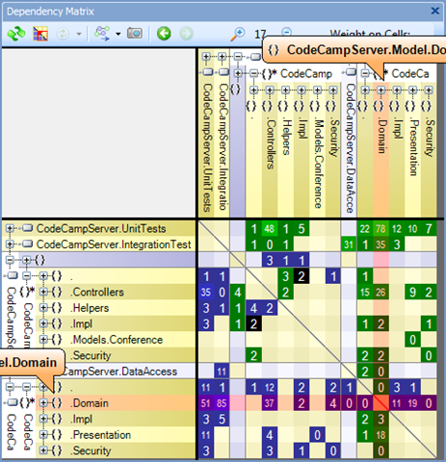
Visual Studio 2010 Ultimate

Slide 13
Google and DSM
PageRank – link analysis on webgraph
Uses Power iteration (also eigenvalue algorithm) and Perron-Frobenuis theorem
More incoming links to a page => more important

Slide 14
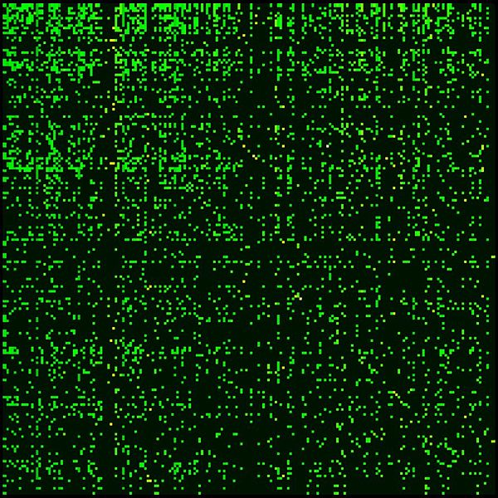
Google Matrix for Wikipedia

Slide 15
Google matrix of Cambridge University network (2006), N=212710

Slide 16
Technological risk DSM
Obtained using values from the standard DSM multiplied with the risk factors - element a_{ij} from DSM is multiplied with the risk factors of i-th and j-th entity.
For example, dependency value between H and J elements in the Fig. 1 is 4, risk factors for both components are 3, and that gives risk value of 36.
Simplified example: NASA’s SAMPEX spacecraft

Slide 17
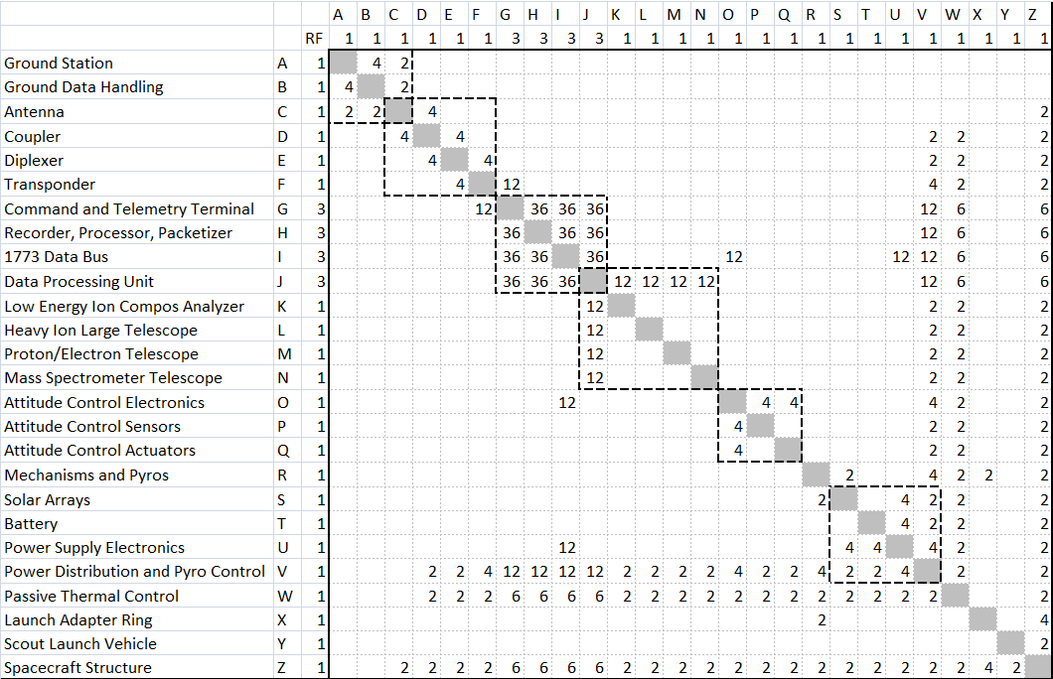

Slide 18
Prioritizing risks
Ranking vector r =( r₁ ,…, r_{j} )
The ranking place of an entity should be proportional to its risk, that is,
Ar =λr
where A is DSM
Conclusion: r is eingenvector

Slide 19
Ranking the tasks
According to the Peron-Frobenius theorem there is exactly one positive eigenvalue largest in magnitude ( equal to the spectral radius of A) and the corresponding eigenvector with positive elements.
Eigenvector v_{m} of the largest eigenvalue λ_{m} gives the ranking of the entities (risks in our case).

Slide 20
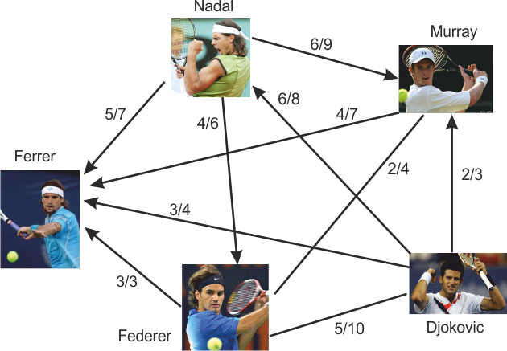
Simple example: Tennis 2010-2011

Slide 21
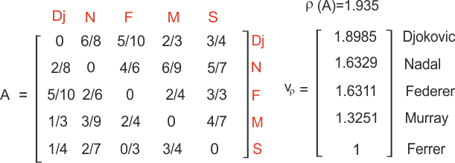
Ranking using DSM and Perron-Frobenius t.

Slide 22
 | Entities | Risk factor (1-5) | Corresponding vector elements
J | Data Processing Unit | 3 | 0.486452
I | 1773 Data Bus | 3 | 0.477916
G | Command and Telemetry Terminal | 3 | 0.473491
H | Recorder, Processor, Packetizer | 3 | 0.468911
V | Power Distribution and Pyro Control | 1 | 0.207764
Z | Spacecraft Structure | 1 | 0.109945
W | Passive Thermal Control | 1 | 0.109750
U | Power Supply Electronics | 1 | 0.059738
F | Transponder | 1 | 0.058981
K | Low Energy Ion Compos Analyzer | 1 | 0.056467
L | Heavy Ion Large Telescope | 1 | 0.056467
M | Proton/Electron Telescope | 1 | 0.056467
N | Mass Spectrometer Telescope | 1 | 0.056467
O | Attitude Control Electronics | 1 | 0.056217
R | Mechanisms and Pyros | 1 | 0.010943
E | Diplexer | 1 | 0.009460
S | Solar Arrays | 1 | 0.009414
T | Battery | 1 | 0.009229
P | Attitude Control Sensors | 1 | 0.009110
Q | Attitude Control Actuators | 1 | 0.009110
D | Coupler | 1 | 0.007604
X | Launch Adapter Ring | 1 | 0.003869
C | Antenna | 1 | 0.002113
Y | Scout Launch Vehicle | 1 | 0.001855
A | Ground Station | 1 | 0.000036
B | Ground Data Handling | 1 | 0.000036

Slide 23
Risk assessment in software development process
Identify risk factor for each work item (task or bug)
TFS support exists
Create dependency matrix
Rank work items

Slide 24
Conclusion
Including dependencies while assessing risks gives more realistic picture
Add-on for TFS
Using interval arithmetic in dependency matrix - more flexible estimation

Slide 25
Thanks for your attention!

